Slide 1
Increasing Your Country’s Happiness
An app that facilitates fundamental policy decisions

Slide 2
Objectives
Present an R-Shiny app that helps country officials facilitate policy decisions related to happiness of their people.
Illustrate the use of the app with a fictitious “case study”.

Slide 3
Brief intro to “Development & Happiness of Countries” app

Slide 4
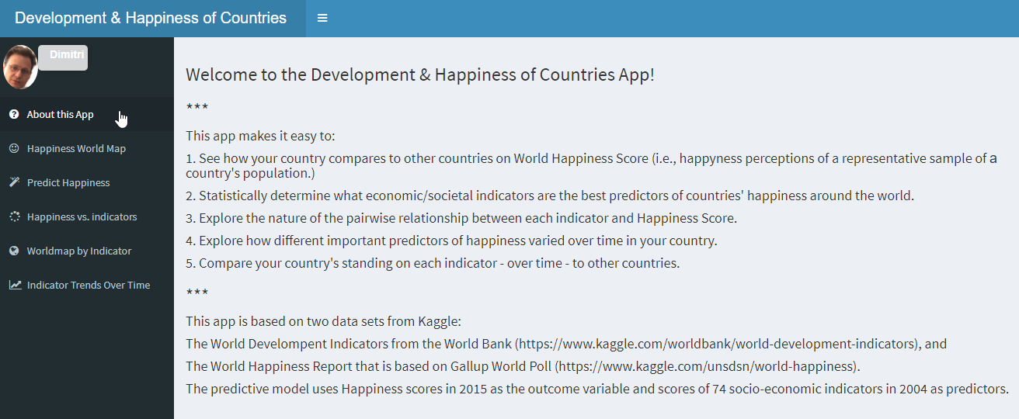
Tab 1: About the App:
Brief intro; tabs on the left reflect the suggested “workflow”.

Slide 5
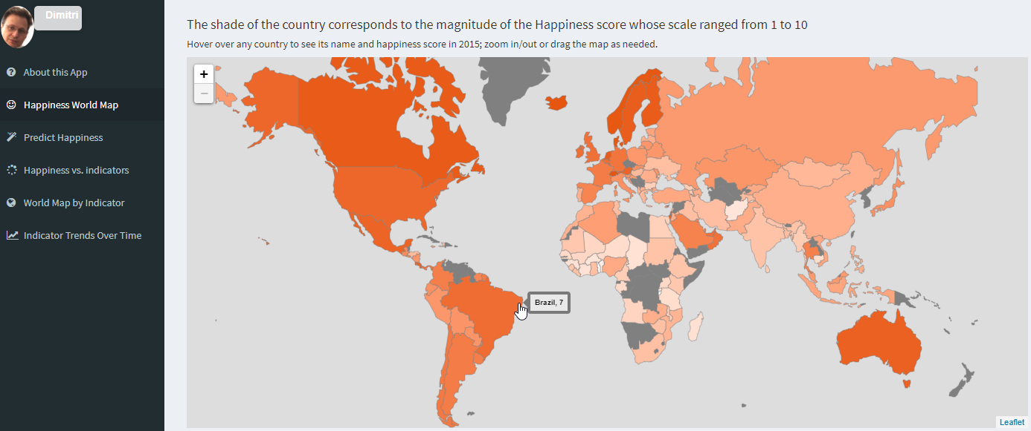
Tab 2: Happiness World Map
Explore the world map where country color corresponds to its happiness score:

Slide 6
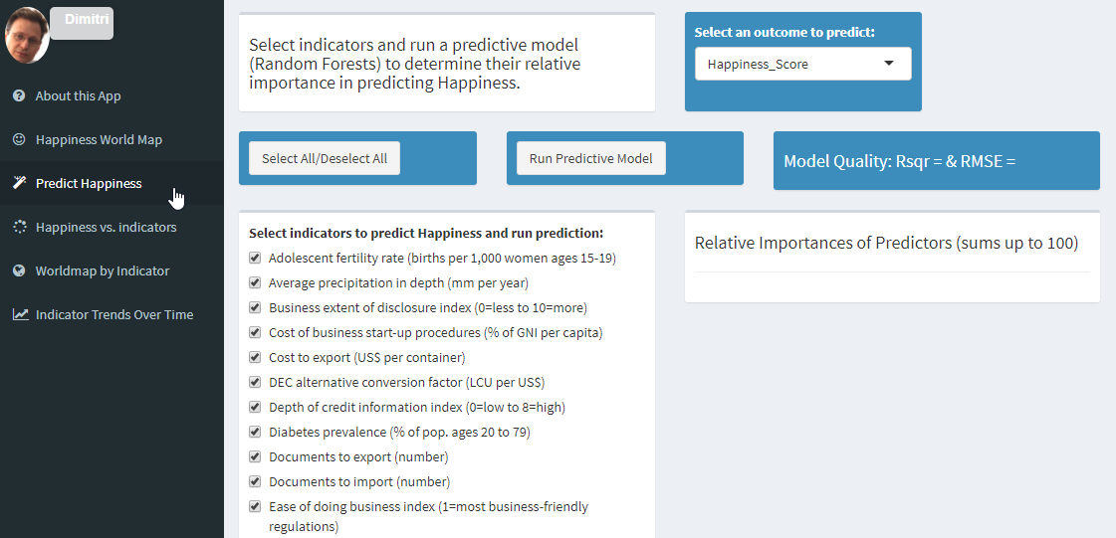
Tab 3: Predict Happiness
Run a model predicting Happiness based on socio-economic indicators of your choice;
Explore the relative importance of predictors you used.

Slide 7
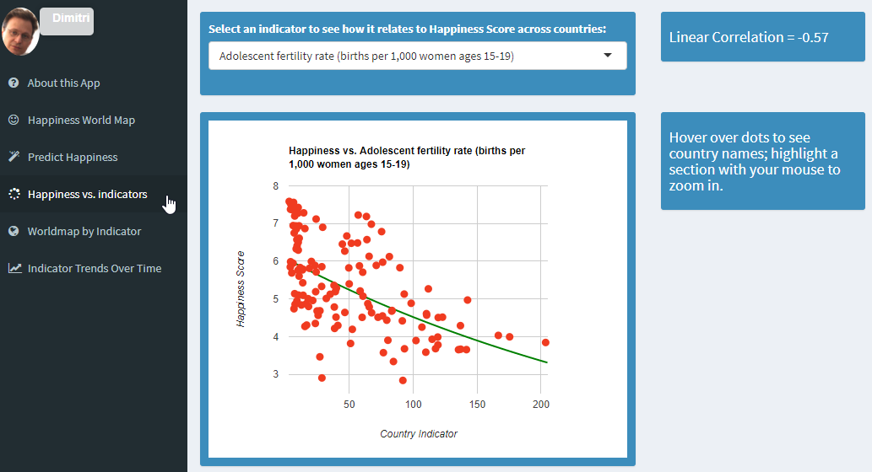
Tab 4: Happiness vs. Indicators
Assess and visualize the bivariate relationship between any indicator and Happiness:

Slide 8
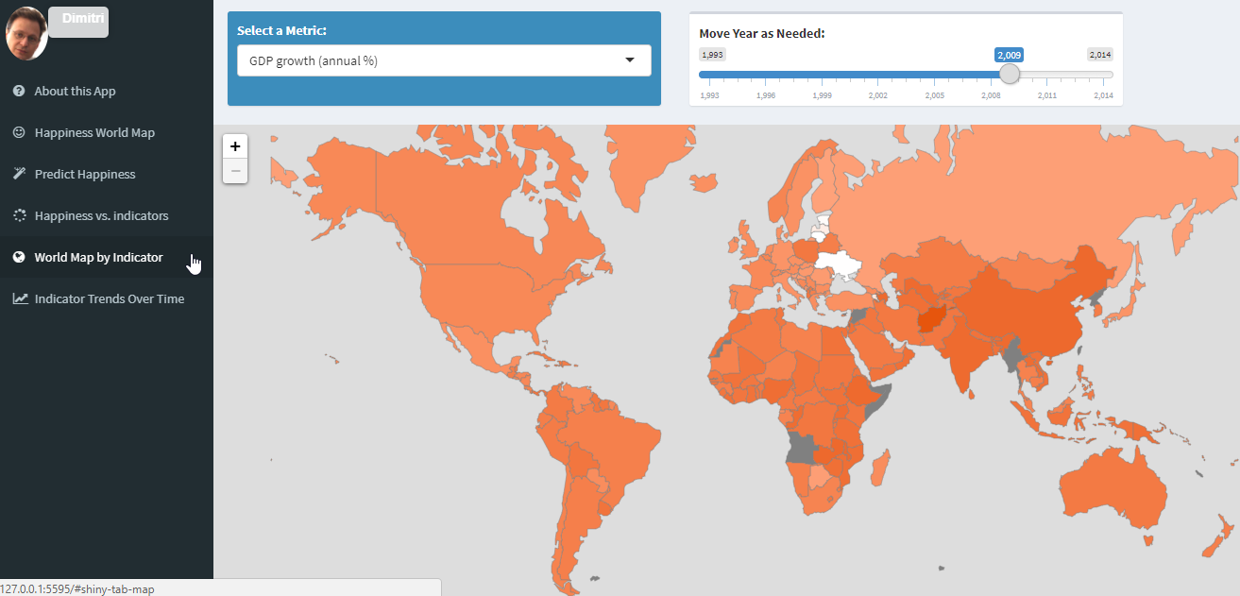
Tab 5: World Map by Indicator
Pick an indicator and explore how it changed over time for countries around the world.

Slide 9
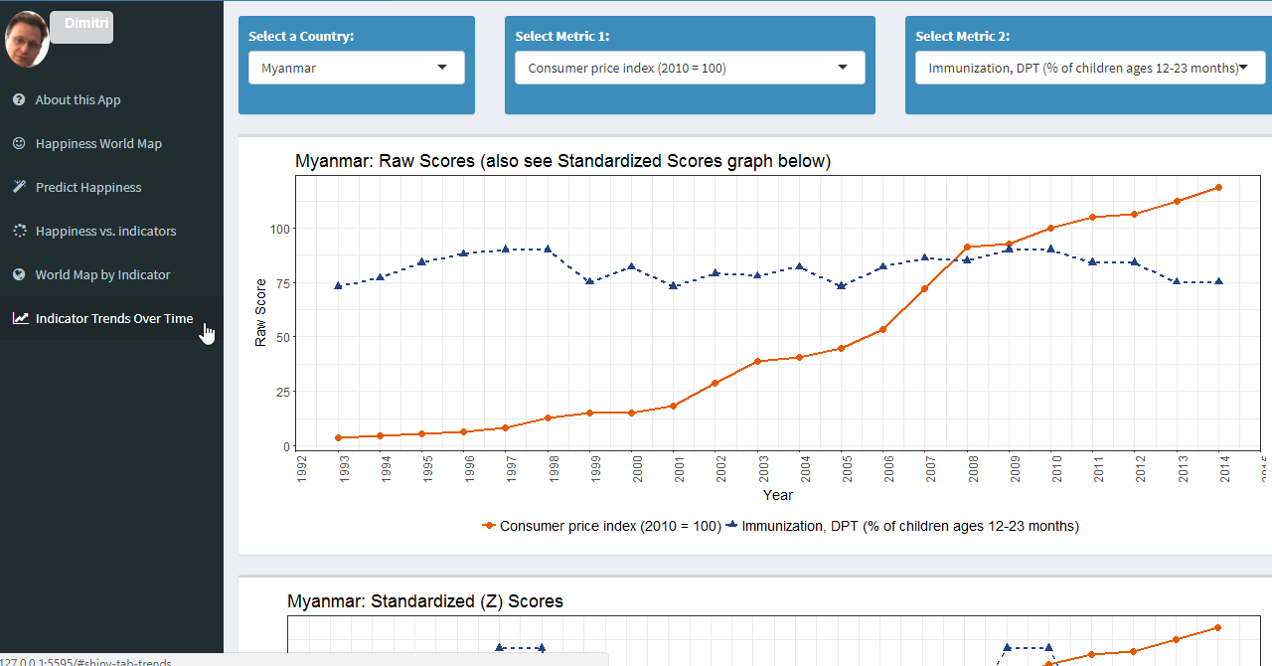
Tab 6: Indicator Trends over Time
For any country: explore indicator trend over time and juxtapose any 2 indicators:

Slide 10
A Fictitious Case Study

Slide 11

Government of Bangladesh is interested in increasing Happiness of their people.
But how to approach it?

Slide 12
Fortunately, the government officials have heard of a nifty online Machine Learning App that uses:
Country Happiness scores from Gallup’s World Happiness survey, and
World Bank’s World Development Indicators

Slide 13
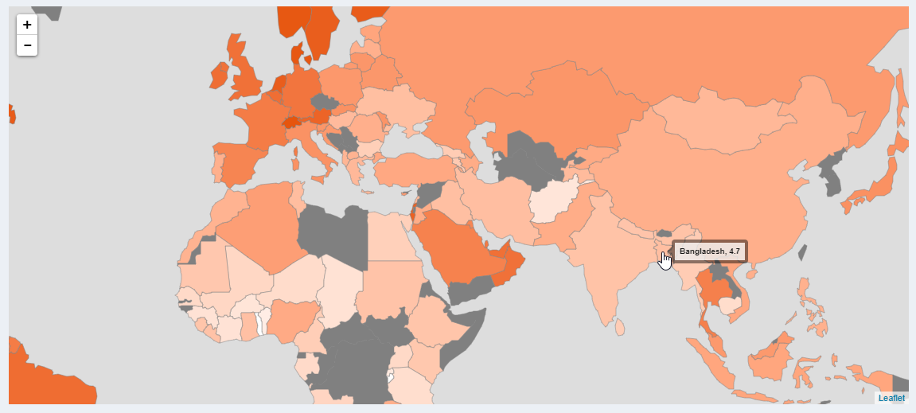
Maybe people of Bangladesh are already happy? How do we compare to others on Happiness?
Not so well! Our color is pale, our Happiness score is just 4.7 – a lot of room for improvement!
Step 1:
Country Happiness Score

Slide 14
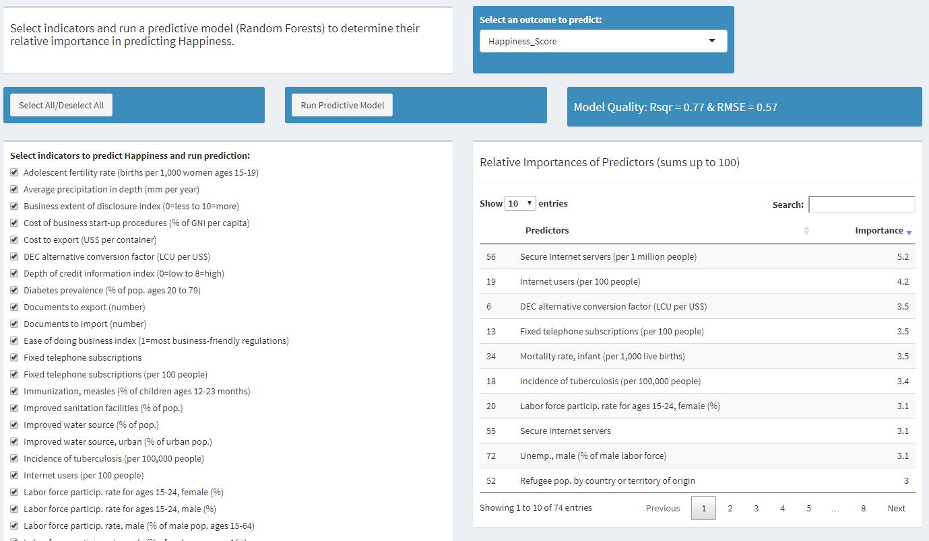
Their model has 74 socio-economic indicators. How well do those – as a group – predict Happiness?
Wow, quite well: an R² of 0.77 is very impressive!
Step 2a:
Predicting Happiness

Slide 15
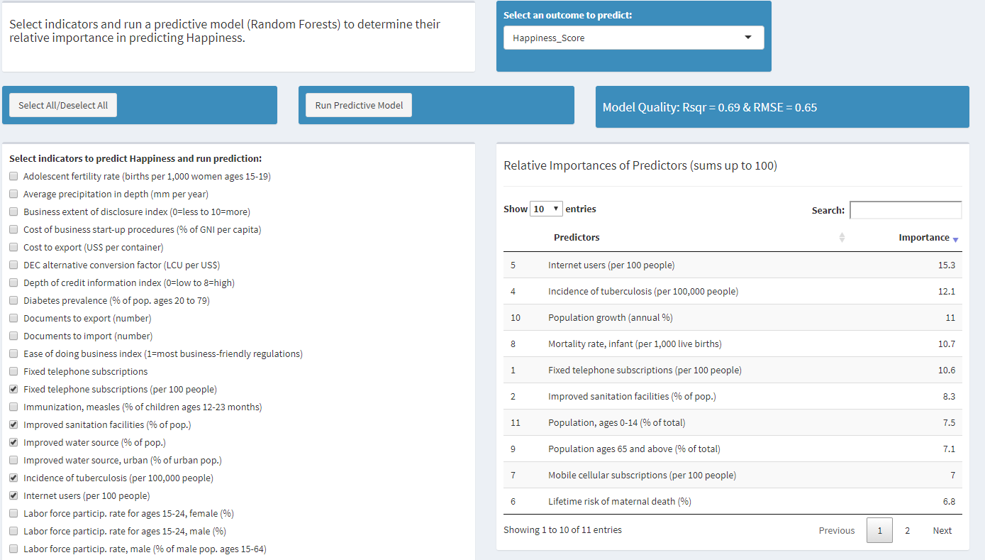
We can’t focus on all indicators, but are ready to consider 13. How well do those 13 predict Happiness?
Very well! An R² of 0.69! And the RMSE decreased from 0.57 to just 0.65!
Step 2b:
Predictor Importance
We were very smart to select those few indicators!!!
We can see the most important predictors of Happiness!

Slide 16
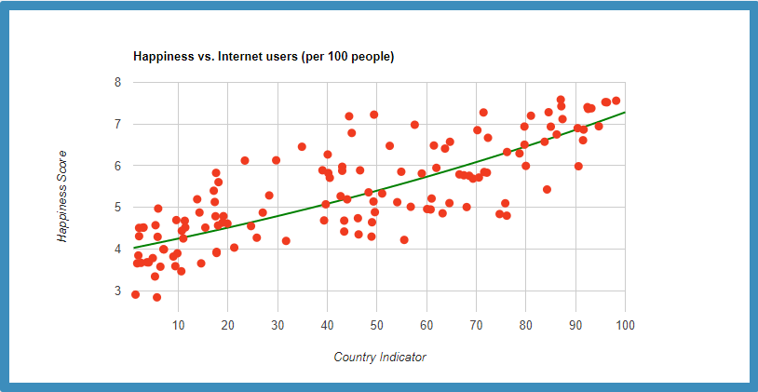
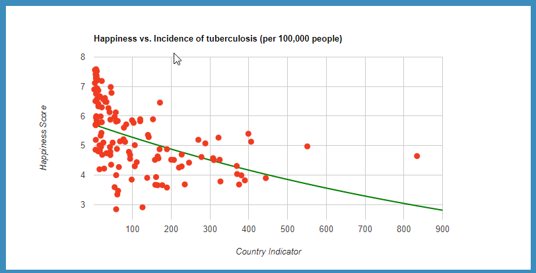


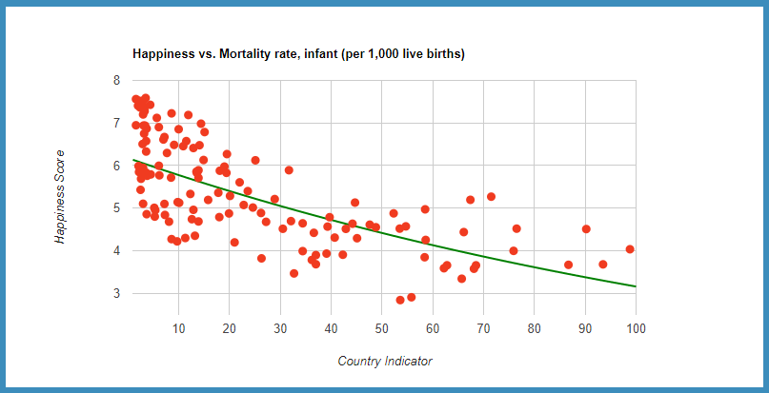
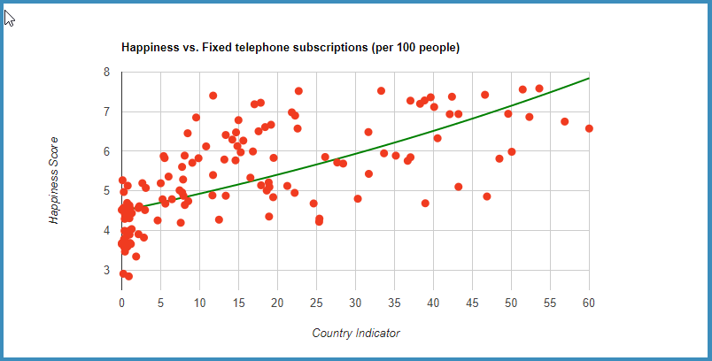


How exactly do the most important predictors relate to Happiness?
Some of them are related positively and some inversely; impressive correlations!
Step 3:
Happiness vs. Indicators

Slide 17
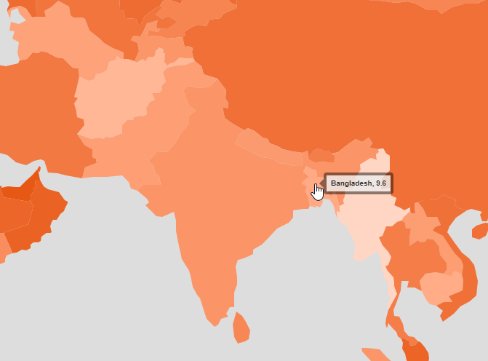
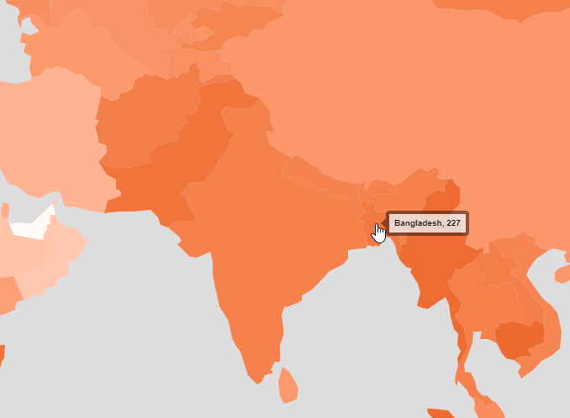
Where do we stand on those important indicators compared to others in the world/region?
Not so great on Internet Usage; still quite high incidence of tuberculosis.
Internet Users (per 100 people)
Incidence of Tuberculosis (per 100,000 people)
Step 4:
Standing on important indicators

Slide 18
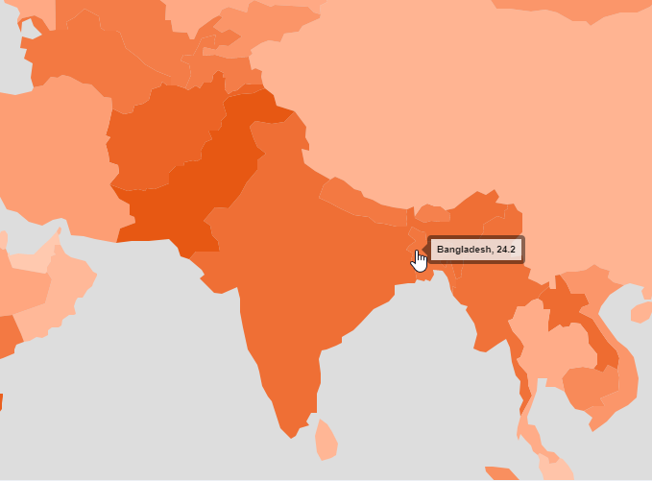
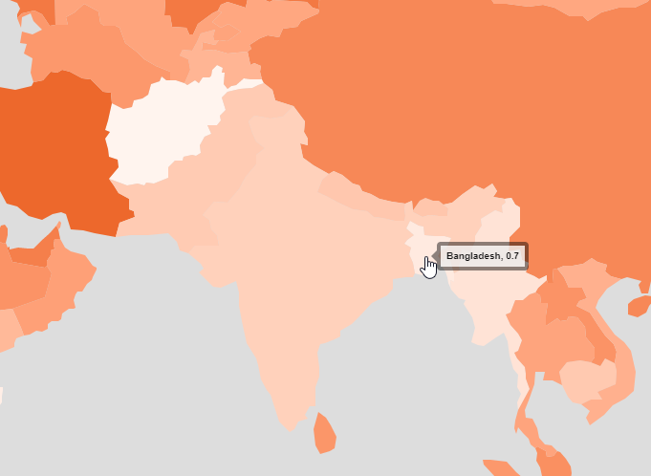
Where do we stand on those important indicators compared to others in the world/region? (cont’d 1)
Relatively high infant mortality rate; very low number of fixed phone subscriptions.
Infant mortality rate ( per 1,000 live births)
Fixed telephone subscriptions (per 100 people)
Step 4:
Standing on important indicators

Slide 19
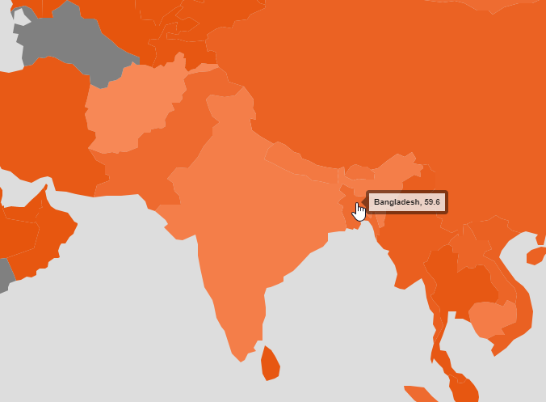
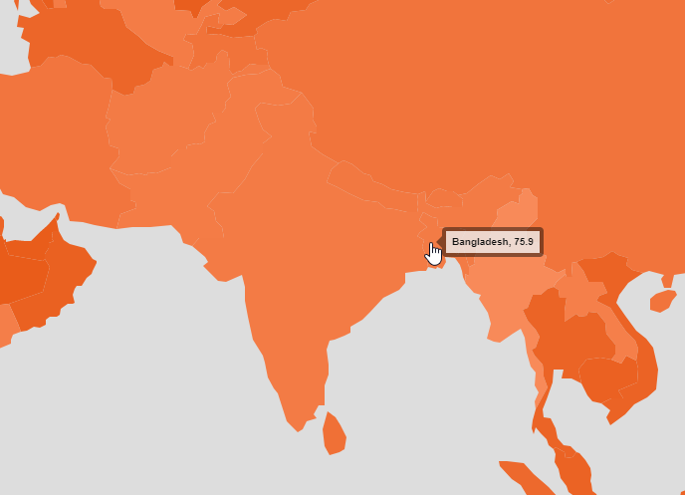
Where do we stand on those important indicators compared to others in the world/region? (cont’d 2)
Relative success on improved sanitation facilities and on cellular subscriptions.
Improved sanitation facilities (% of population)
Mobile cellular subscriptions (per 100 people)
Step 4:
Standing on important indicators

Slide 20
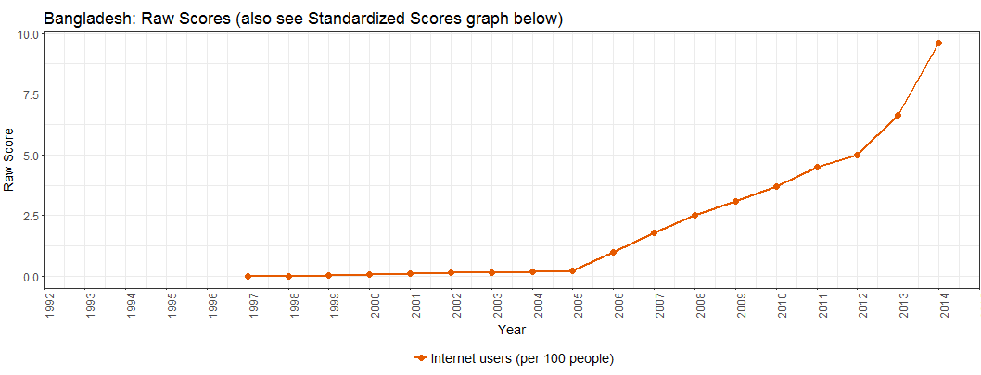
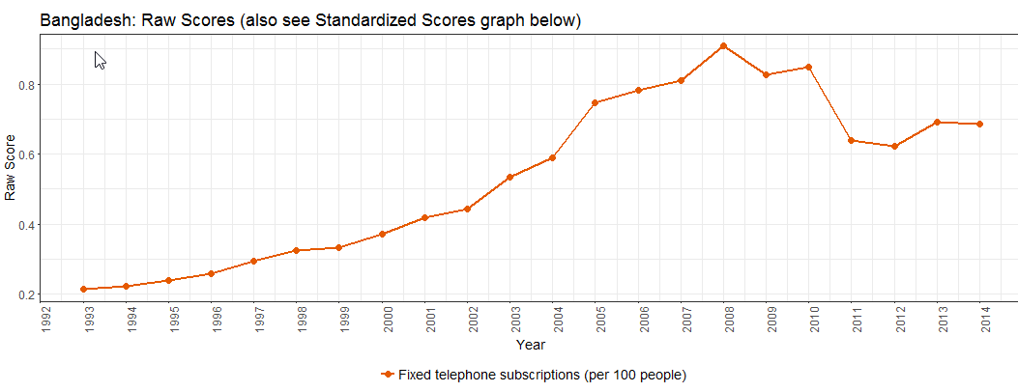
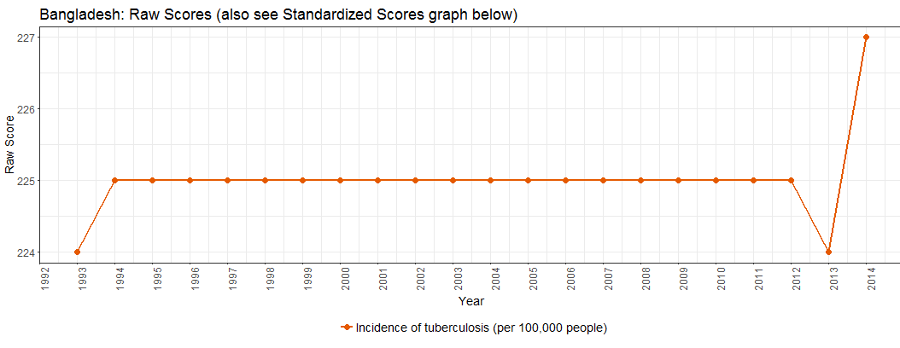
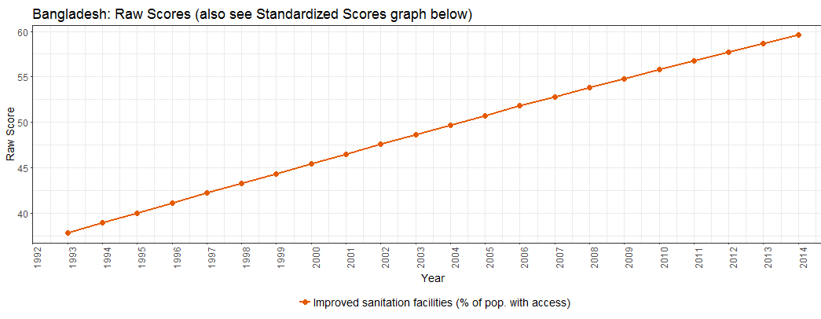
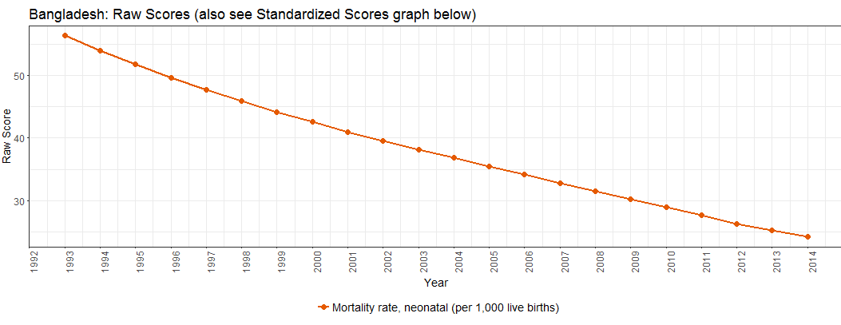
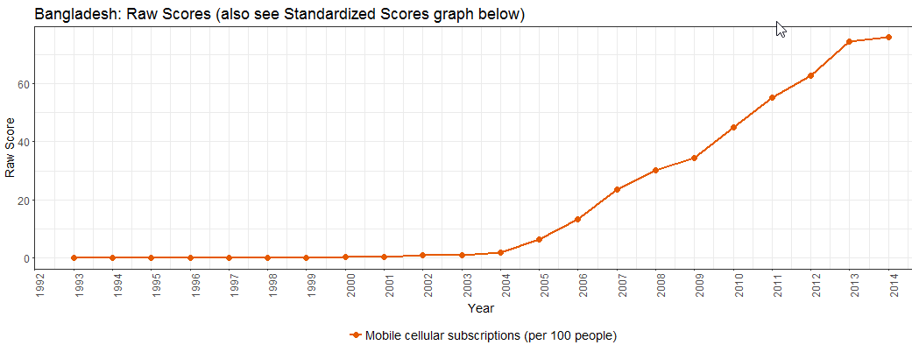
Our trends over time? Little improvement in tuberculosis incidence and number of fixed phone subscriptions
Improvements in Internet use, access to sanitation, & mobile phone usage; falling mortality rates
Internet users
Fixed phone subscriptions
Step 5:
Trends for important indicators
Tuberculosis incidence
Improved sanitation facilities
Neonatal mortality rate
Mobile cellular subscriptions

Slide 21
Summary of top predictors of Happiness, Bangladesh’s standing on them and trends over time
Overall, Bangladesh’s primary focus should be on improving (a) public health: esp., fighting tuberculosis and lowering infant mortality rate; and (b) fixed phone line infrastructure. Thank you, app!!!
Indicator | Importance | Absolute Standing | Trend over time
Internet Users (per 100 people) | 15
Incidence of Tuberculosis (per 100,000 people) | 12
Infant mortality rate ( per 1,000 live births) | 11
Fixed telephone subscriptions (per 100 people) | 11
Improved sanitation facilities (% of pop.) | 8
Mobile cellular subscriptions (per 100 people) | 7

Slide 22
Thank you! Questions?

Slide 23
Appendix

Slide 24
About World Happiness Score and World Development Indicators
WHR has was published in 2012, 2013, 2015, and 2016
World Happiness Scores:
Used regularly by the World Happiness Report.
The actual happiness scores and rankings come from the Gallup World Poll.
The exact wording of the “happiness” question is:
“Please imagine a ladder, with steps numbered from 0 at the bottom to 10 at the top. The top of the ladder represents the best possible life for you and the bottom of the ladder represents the worst possible life for you. On which step of the ladder would you say you personally feel you stand at this time?”
This app used the World Happiness Scores and rankings for 2015 posted on Kaggle.
World Development Indicators:
Are collected and published yearly by the World Bank.
This app used the data on 74 indicators from 1993 to 2014 posted on Kaggle.

